Slide 1
4750 N. Sheridan Road Chicago, IL 60640 Terry Bergdall Part 2

Slide 2
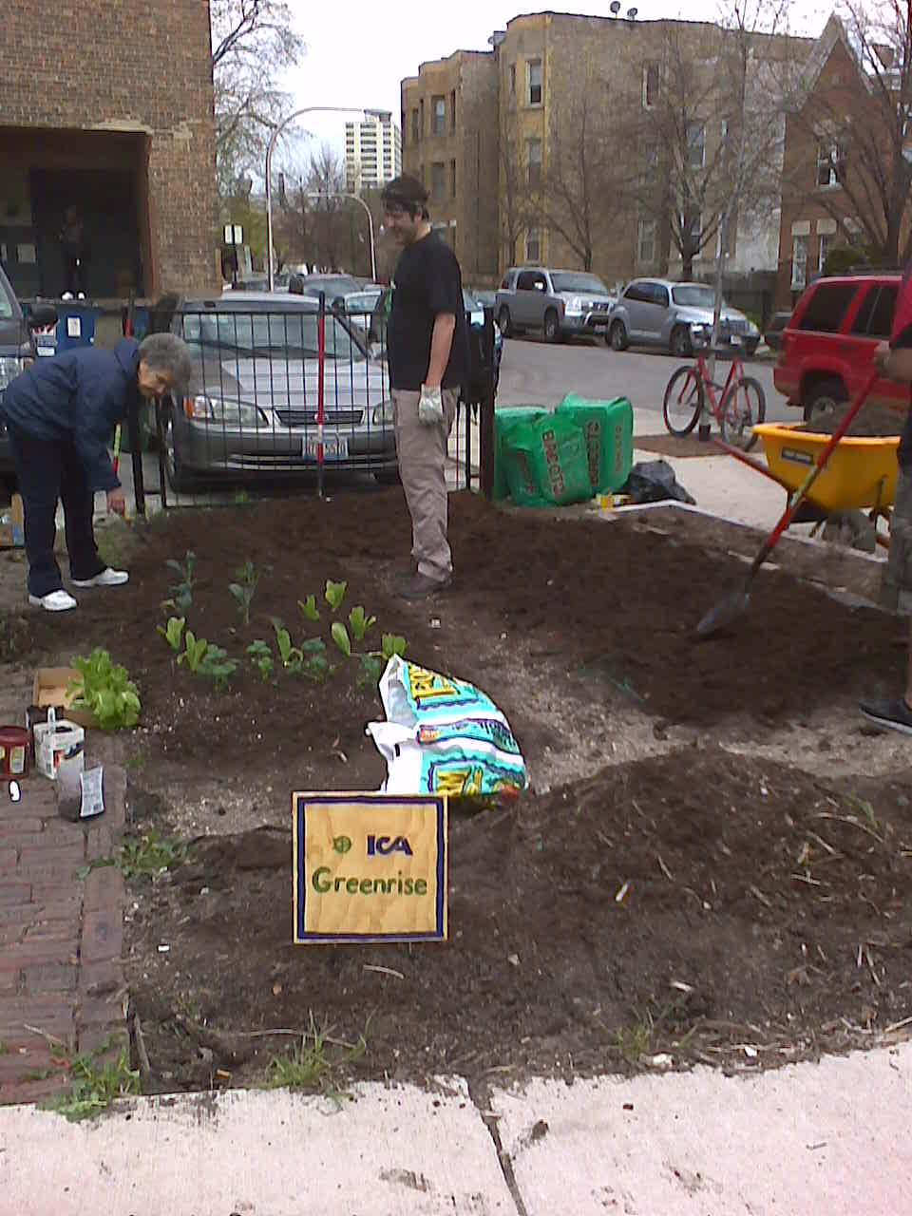
Uptown Community Engagement

Slide 3
Identify - Connect - Accelerate

Slide 4
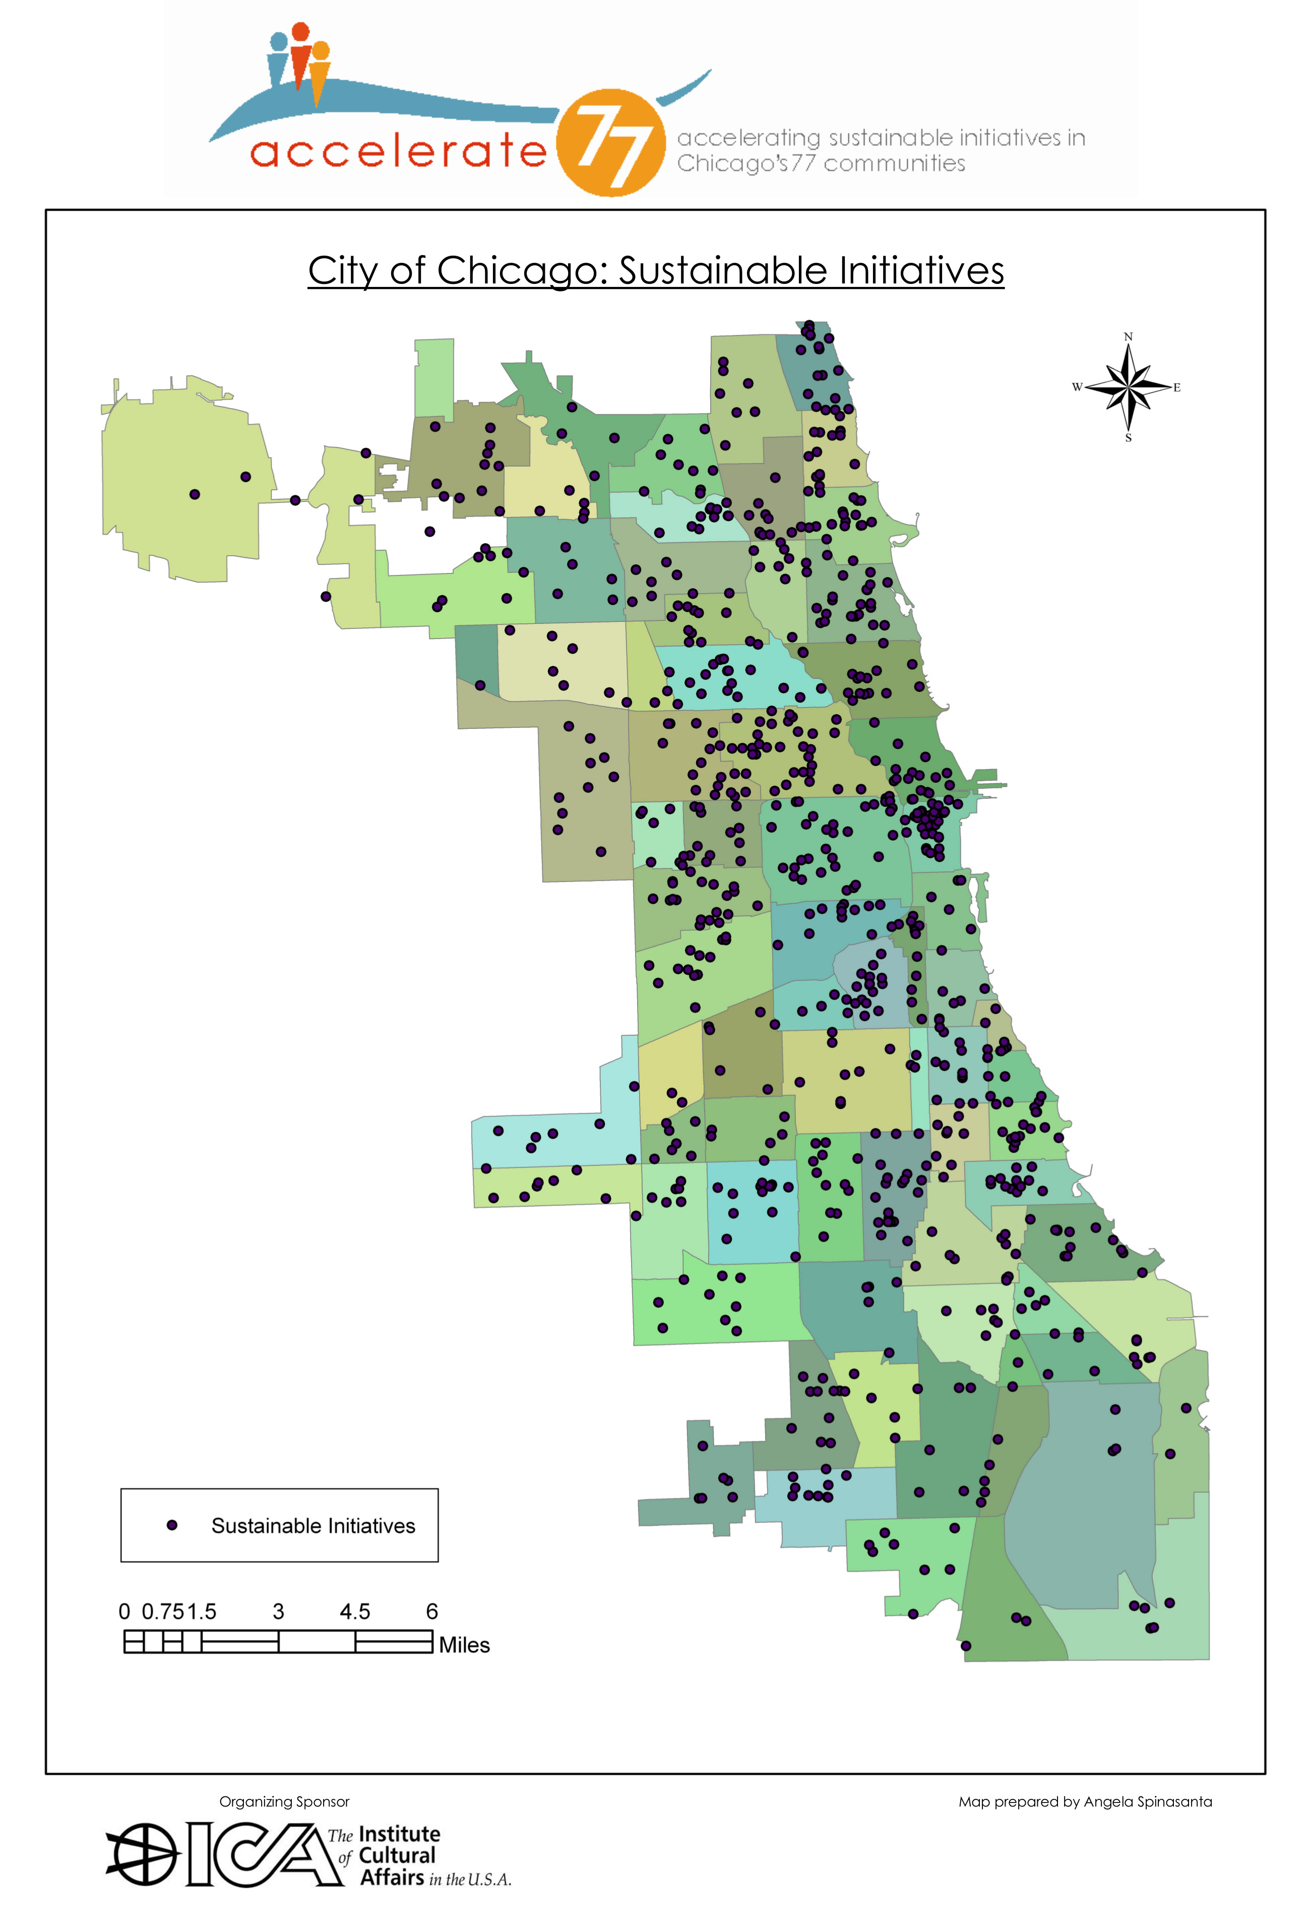

Slide 5
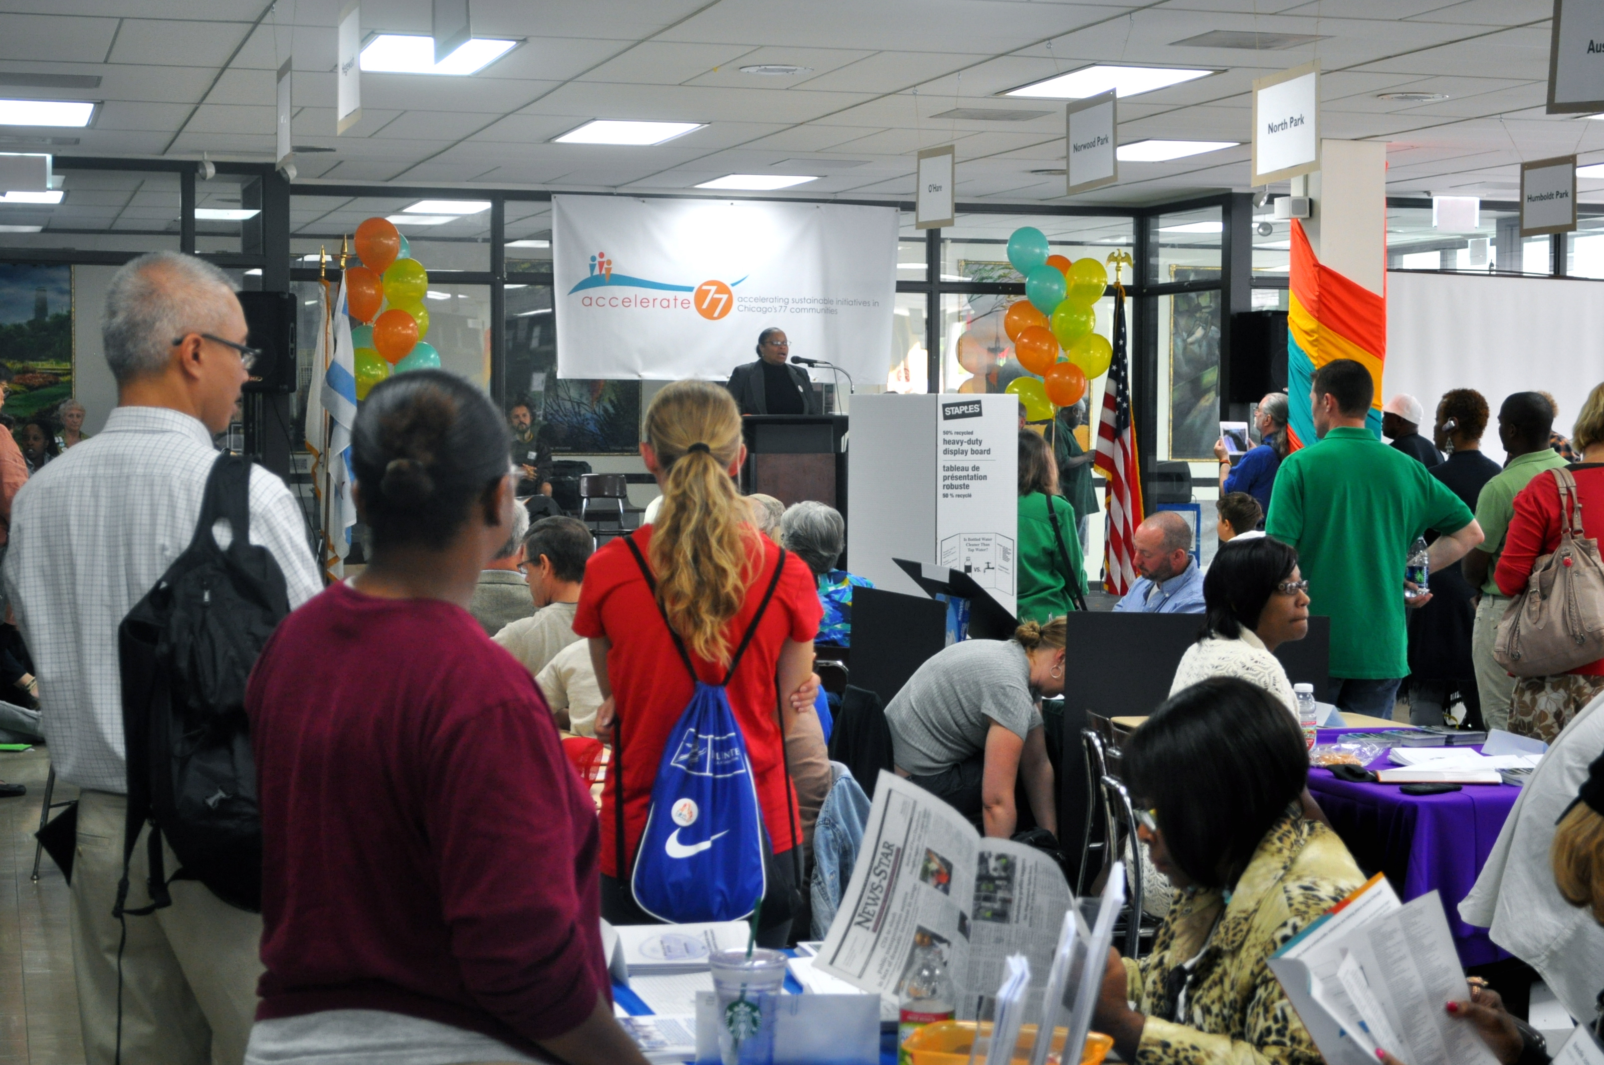

Slide 6
Chicago Sustainability Leaders Network
In-between space of top-down and bottom-up
Collaborative government
Continue the creation of lateral connections
Expanding the table
Empower vertical relationships
Strengthening the voice from below
Develop “soft skills” of community work
Sustainability U

Slide 7
4750 N. Sheridan Road

